Slide 1



Defining Classes
Classes, Fields, Constructors
C# OOP
Basics
SoftUni Team
Technical Trainers
Software University
http://softuni.bg

Slide 2

Table of Contents
Defining Simple Classes
Fields
Constructors

Slide 3
Questions
sli.do #7968

Slide 4
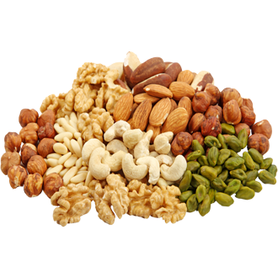
Defining Simple Classes

Slide 5
Classes in OOP
Model real-world objects
Notes:
Describe the structure of objects
Objects describe particular instance of a class

Slide 6
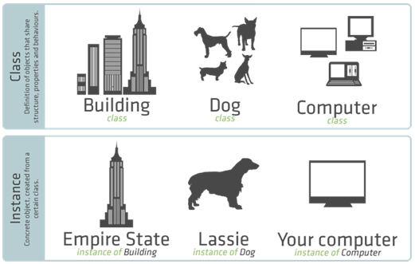
Class Versus Instance

Slide 7
Class Definition and Members
Declaration, Fields
Constructors

Slide 8

Fields
Defining and Using Data Fields

Slide 9
Fields
Fields hold the internal object state

Slide 10
Fields (2)
class Dog
{
string name;
string breed;
int age;
List<Dog> children;
}
Field declarations

Slide 11
The "this" Keyword
Points to the current
instance of the class

Slide 12
The "this" Keyword (2)
class Dog
{
string name;
Dog(string name)
{
this.name = name;
}
}

Slide 13

Fields
Exercises in class

Slide 14

Constructors
Defining and Using Class Constructors

Slide 15
Defining Constructors
class Point
{
int xCoord;
int yCoord;
Point()
{
this.xCoord = 0;
this.yCoord = 0;
}
}
Parameterless constructor

Slide 16
Defining Constructors (2)
class Person
{
string name;
int age;
Person()
{
this.name = null;
this.age = 0;
}
}
As a rule constructors should initialize all class fields

Slide 17
Defining Constructors (3)
class Person
{
string name;
int age;
Person(string name, int age)
{
this.name = name;
this.age = age;
}
}
Constructor with parameters

Slide 18
Chaining Constructors Calls
class Point
{
int xCoord;
int yCoord;
Point()
: this(0, 0)
{
}
Point(int xCoord, int yCoord) {
this.xCoord = xCoord;
this.yCoord = yCoord;
}
}

Slide 19
Constructors
Live Demo

Slide 20

Summary
Classes define specific structure for objects
Objects are particular instances of a class
Classes define fields, constructors and other members
Constructors are invoked when creating new class instances and initialize the object's internal state

Slide 21








OOP – Defining Classes
httpshttps://softuni.bg/csharp-basics-oop

Slide 22

License
This course (slides, examples, demos, videos, homework, etc.) is licensed under the "Creative Commons Attribution-NonCommercial-ShareAlike 4.0 International" license
Attribution: this work may contain portions from
"Fundamentals of Computer Programming with C#" book by Svetlin Nakov & Co. under CC-BY-SA license
"OOP" course by Telerik Academy under CC-BY-NC-SA license

Slide 23






Free Trainings @ Software University
Software University Foundation – softuni.org
Software University – High-Quality Education, Profession and Job for Software Developers
softuni.bg
Software University @ Facebook
facebook.com/SoftwareUniversity
Software University @ YouTube
youtube.com/SoftwareUniversity
Software University Forums – forum.softuni.bg

